Slide 1
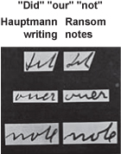
Based on comparing the handwriting on the document in question to that of the suspect, is this a positive match of suspects? Why or why not?
Suspect non-request sample
Document in
question

Slide 2
In Search of the Lindbergh Kidnapping
Part II

Slide 3
Correct answer???
Let’s read about it to find out . . .
The Lindbergh Baby Kidnapping
Read article→→→

Slide 4
As a group, create a PowerPoint presentation including the following components:
Research—Who is Charles A. Lindbergh?
Map out the outdoor portion of the crime scene. Include names and images of each piece of evidence found.
Evidence—list, picture, describe the mounting evidence against the suspect
Research—The handwriting analysis is only mentioned in this article. Research and show examples of how handwriting was used as evidence in this case.
Create a timeline of the events. Include: Date of kidnapping, ransom notes, contacts with kidnappers, money exchange, body, gold notes, arrest, trial/verdict (Note: Timeline can cover two slides)

Slide 5
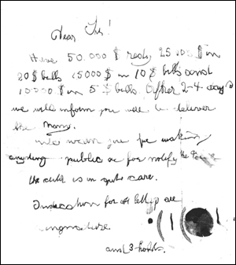
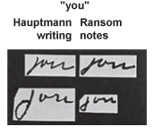
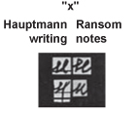
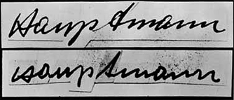
The Lindbergh Baby Kidnapping
Handwriting comparisons
First ransom note
Known Signature of Hauptmann
Composite Signature-Individual letters from the ransom notes

